Slide 1
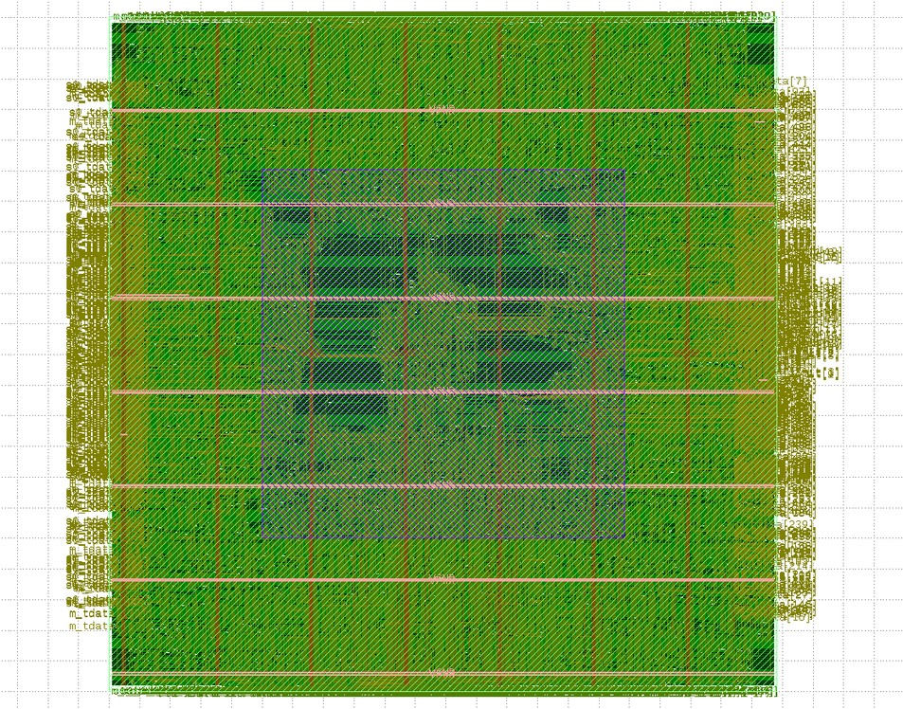
SARCATHON 2026 · SEMICON HACKATHON
AXI4-Stream to
PCIe 6.0 Bridge
RTL integration, Vivado optimisation and SKY130 implementation
Team RoboKnights
Aditya Jain · Swaray Agrawal · Kshitij Seshadri
SKY130 interconnect layout view
24 October 2026
FPGA: Xilinx xcu250 | ASIC: SkyWater SKY130A
Notes:
Title (≈ 40 s) · Aditya
*[Title slide on screen]*
> Good morning. We're Team RoboKnights: I'm Aditya, with Swaray and Kshitij.
>
> Our project is an RTL bridge that takes data from two FPGA-fabric producers — a SmartNIC and an ML inference accelerator, each on a 512-bit AXI4-Stream port — and delivers it into host memory over a PCIe 6.0 Flit-mode link.
>
> The design is split into three layers, one per person:
> - I built the interconnect: the two ingest ports, the arbiter and the clock crossing.
> - Swaray built the link layer: TLPs, Flits, CRC and FEC, and replay.
> - Kshitij built the protocol-to-PHY layer: the PAM4 lanes, link training, resets, config space, BAR0 registers and MSI-X interrupts.
>
> We took it to FPGA timing closure on a Xilinx Alveo U250 part, and through the open-source flow to GDSII on SkyWater 130 nanometre.
*[Point to the layout image]* This is the interconnect layout from that flow.

Slide 2
RoboKnights / SARCathon 2026
02
Round 1 — RTL development and initial verification
By 15 October, the three layers passed their unit tests and were connected in a first system-level loopback.
Interconnect
Link layer
Protocol / PHY
Aditya
Swaray
Kshitij
•
Dual 512-bit AXI4-Stream ingest ports
•
Write and replay buffers, 256-byte Flit
•
Gray/PAM4 lane mapping and logical PHY
(SmartNIC and ML).
framing, DLLP parsing.
loopback.
•
Weighted arbitration, session / offset
•
CRC/FEC and TLP-related blocks
•
Reset, configuration, MSI-X and sideband
tracking and async FIFO.
individually unit-tested.
controls.
•
Four RTL bugs fixed; 128/128 checked
•
Transaction blocks not yet wired into the
•
4/4 initial cocotb tests passed; lane proofs
beats, zero errors.
complete path.
checked.
Status at submission
Connectivity was demonstrated; end-to-end TLP data correctness, complete address handling and link-to-PHY
backpressure remained open.
AXI4-Stream → PCIe 6.0 Bridge | Round 2 technical review
2 / 10
Notes:
Round 1 (≈ 50 s) · Aditya
> In Round 1, up to 15 October, each of us built and unit-tested our own layer.
>
> *[Left column]* The interconnect was complete. We fixed four real bugs, including an arbiter deadlock and a combinational loop in the FIFO's full flag, and the integration bench passed 128 out of 128 beats.
>
> *[Middle column]* The link layer's core blocks — write buffer, replay buffer, Flit framing — were working and unit-tested, but the transaction blocks weren't yet wired into one path.
>
> *[Right column]* The PHY lane chain was bit-exact in loopback, the reset, config and MSI-X control plane existed, and 4 out of 4 cocotb tests passed.
>
> *[Bottom bar]* So at the Round 1 submission the layers were connected, but we hadn't yet shown data correctness end to end: there was no TLP packetizer, and no back-pressure between the link and the PHY. Round 2 started there.

Slide 3
RoboKnights / SARCathon 2026
03
Round 2 — full integration and regression testing
Closed the gaps between the three RTL layers before committing to FPGA performance optimisation.
Simplified data path
What changed
ch0: SmartNIC
ch1: ML accel
•
Link-to-PHY FIFO and explicit ready / backpressure.
•
Shared TUSER definition; host BAR0 registers and address translation.
interconnect_top
512-bit AXI4-S · WRR · sessions · CDC
•
TLP packetisation, ACK/NAK replay and link-down recovery.
link_layer_top
•
Corrected malformed TLP, overflow, CRC/FEC and cross-layer data-loss cases.
TLP → Flit · CRC/FEC · ACK/NAK replay
Verification at the Round 2 cutoff
pcie_phy_top
144/144
TLPs delivered in Step 1 integration test
PHY FIFO · PAM4 / Gray logical lanes
73/73
Required coverage bins across 40 random seeds
4/4
Formal proofs completed
PCIe 6 logical link
46
Protected-code regression guards
AXI4-Stream → PCIe 6.0 Bridge | Round 2 technical review
3 / 10
Notes:
Round 2 integration (≈ 70 s) · Kshitij
> Round 2 started with an honest review of the merged repository: all three layers in one tree, one layer at a time.
>
> It found real problems:
> - the layers didn't even compile together, because one module was defined twice;
> - the link layer's replay buffer had no ACK source, so it stopped after 31 beats;
> - the PHY drained data 32 times slower than the link wrote it, with no ready signal between them;
> - the TUSER bits between the interconnect and the link were in a different order, so every beat was routed as channel 0.
>
> *[Point to the diagram]* We fixed those layer by layer.
> - A FIFO and an explicit ready signal between link and PHY.
> - One shared TUSER definition, so the layout can't drift again.
> - Host BAR0 registers for the per-channel base addresses and limits.
> - ACK/NAK replay, and recovery when the link goes down.
>
> On the PHY side we also made the link train itself over the lanes — Detect, Polling with TS1, Configuration with TS2, then L0 — with lane deskew and lane-reversal detection, instead of being told it was trained.
>
> *[Point to the numbers]* The checkpoint at the end of this step:
> - 144 out of 144 TLPs delivered end to end in the integration test.
> - Then CI with 46 protected-code guard rules.
> - A randomized bench over 40 seeds hitting all 73 required coverage bins.
> - 4 formal proofs with SymbiYosys.
>
> Across Round 2 that came to 44 design bugs and 21 testbench bugs, each one tracked in our ledger with who found it, who fixed it and which patch carries it.

Slide 4
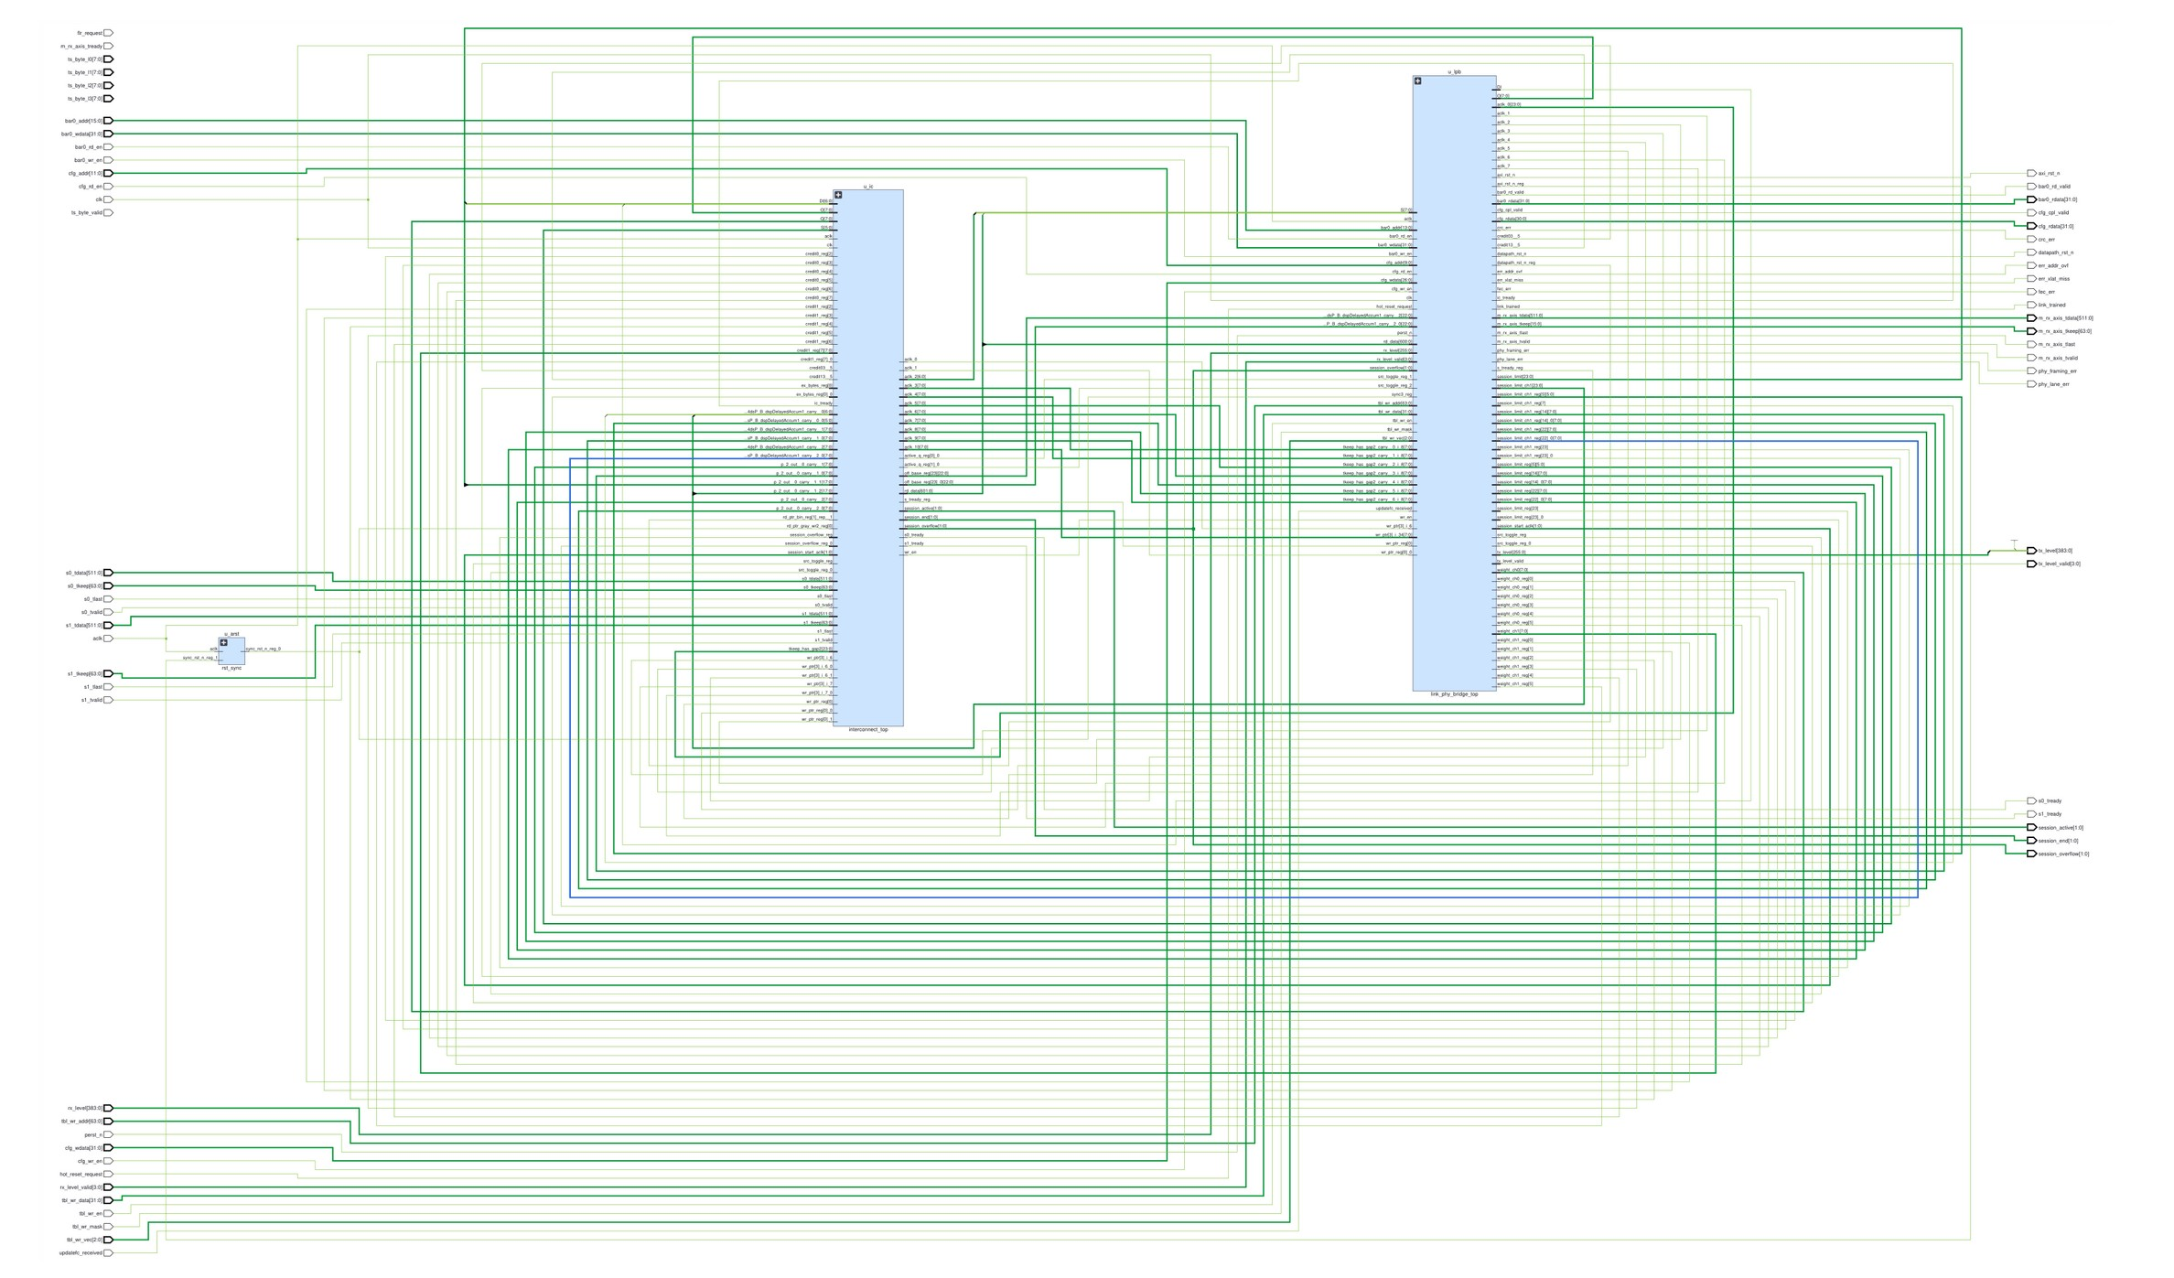
RoboKnights / SARCathon 2026
04
Vivado synthesis — generated bridge schematic
Structural connectivity view from Vivado for bridge_top; shown as synthesis evidence, not a timing or post-route result.
How to read the figure
Hierarchy
The synthesized bridge_top view
contains interconnect_top,
link_phy_bridge_top and
reset/control structures.
Visible interfaces
AXI4-Stream data/keep/valid-
ready, BAR0/config, link status,
reset and PHY lane signals.
Interpretation
Generated netlist connectivity;
functional and timing claims are
supported separately by testbench
and Vivado reports.
Source: synth_design_schematic(1).pdf · Vivado Nlview, bridge_top · October 24, 2026
AXI4-Stream → PCIe 6.0 Bridge | Round 2 technical review
4 / 10
Notes:
Vivado schematic (≈ 30 s) · Swaray
> This is the synthesized netlist of the whole bridge from Vivado. It isn't a timing result; it's evidence that the full hierarchy synthesizes as one design.
>
> *[Right panel]* You can see `interconnect_top`, the link-and-PHY block and the reset structures, with the AXI4-Stream, BAR0 and lane interfaces at the boundary. The functional and timing claims are backed separately by the testbenches and the Vivado reports on the next slides.
*(Keep this short — it's a visual check, not a talking slide.)*

Slide 5
RoboKnights / SARCathon 2026
05
Vivado — timing progression across the optimisation runs
PCIe clock target: 250 MHz (4.0 ns) on xcu250, Vivado 2026.1.
PCIe Fmax (MHz)
255
250 MHz target
248
What the timing reports
250
showed
200
118 → 49 MHz
147
Widening the datapath created an
unrolled 51-level CRC-64 critical
150
118
path.
100
Recovery
39
49
50
Split CRC computation, constant-
mask XOR trees, pipelined RX
processing and decoupled
0
TREADY logic.
Initial
Step 4
Wave
Wave C
Freeze
Final
base
A+B
19,046 → 0
failing endpoints (Step 4 base → final)
AXI4-Stream → PCIe 6.0 Bridge | Round 2 technical review
5 / 10
Notes:
Timing progression (≈ 70 s) · Swaray
> This chart is the story of our clock speed. The target is 250 MHz on the PCIe clock.
>
> *[Point along the bars]*
> - The very first build ran at 39 MHz.
> - After the integration fixes we had a clean, fully verified base at 118 MHz.
> - Then we did the obvious thing for throughput and widened the datapath to 512 bits end to end — and Fmax dropped to 49 MHz.
>
> We didn't hide that. The timing report showed exactly why: the CRC-64 over the whole Flit had become one combinational cone, 51 logic levels in a single cycle.
>
> So we split the CRC into per-chunk parts that are combined, which got us to 147 MHz. We then rewrote CRC and FEC as constant-mask XOR trees and registered the inbound beat, which got us to 248 MHz at the freeze. The last step, to 255 MHz, came from a fix the ASIC flow forced on us, on the next slide.
>
> *[Bottom line]* Failing timing endpoints went from 19,046 to zero.

Slide 6
RoboKnights / SARCathon 2026
06
RTL changes that mattered most
Widen the datapath for throughput, pipeline it for clock speed, then fix the protocol so no data is lost.
Bottleneck
RTL change
Measured result
32-bit TX serialiser, one TLP per Flit
512-bit tlp_tx_wide engine; merges beats into Max-Payload TLPs,
ML 0.06 → 6.17 GB/s
split at 4 KB
about 100×
RX decoded 1 DW per clock; PHY
16-DW/clock RX delimiter; wide PHY (8 B/lane/clk) with FIFO
NIC p99 58 → 0.59 µs
32× slower than link
back-pressure
4.84 Mpps SmartNIC IMIX
CRC-64/FEC: 51 logic levels in one
Pipelined check; CRC/FEC as constant-mask XOR trees
49 → 248 MHz
cycle
TKEEP → popcount → limit →
TREADY independent of TKEEP; near-limit beat checked one
255 MHz, all paths met
TREADY: 27 ns
cycle later (X.1)
ASIC slack −12 → −0.5 ns
Replay never ACKed, FEC couldn't
ACK/NAK replay, SEC-DED FEC + CRC-64, credit flow control,
Zero data loss
correct, link hung on cable pull
link recovery (K6)
1,069 errors corrected, 7 cable pulls recovered, 40 random
seeds
Overall
118 → 255 MHz (2.2×) with 2% more LUTs, because the wide path replaced the serial one rather than adding to it.
AXI4-Stream → PCIe 6.0 Bridge | Round 2 technical review
6 / 10
Notes:
RTL changes that mattered most (≈ 100 s) · Swaray + Kshitij
> Here are the five changes with the biggest measurable result, each with its number. The pattern is: widen the datapath for throughput, pipeline it for clock speed, then make the protocol lose nothing.
*[Row 1 — Swaray]*
> The old design squeezed 512-bit beats through a 32-bit serialiser and put one TLP in each Flit. We made the TLP engine as wide as the bus and merged beats into max-payload TLPs that never cross a 4 KB boundary. ML throughput went from 0.06 to 6.17 gigabytes per second — about 100 times.
*[Row 2 — Kshitij]*
> Receive and PHY had to keep up with the wider transmit side, or the latency would just move downstream. The RX now decodes 16 DWs per clock instead of one, and the PHY moves 8 bytes per lane per clock instead of one byte per four clocks, with FIFO back-pressure so nothing is dropped. SmartNIC tail latency went from 58 to 0.59 microseconds, at 4.84 million packets per second.
*[Row 3 — Swaray]*
> Widening first dropped us to 49 MHz, because CRC-64 became one huge cycle. Splitting it into XOR trees got us to 248.
*[Row 4 — Aditya or Swaray]*
> On the ASIC slow corner, the path from TKEEP through a popcount and the limit compare to TREADY took 27 nanoseconds. We made TREADY independent of TKEEP and check only a beat near the session limit one cycle later. That fixed the ASIC slack, from −12 to −0.5 nanoseconds, and it also gave the FPGA its last margin: 255 MHz with every path met.
*[Row 5 — Kshitij]*
> Speed means nothing if data is lost. The replay buffer now really gets ACKs and NAKs, FEC actually corrects, there's CRC-64 and real credit flow control, and the PHY recovers when the cable is pulled. Over 40 random seeds the bench corrected 1,069 errors and recovered from 7 cable pulls with zero data loss. These fixes came from a random test bench that reaches every error path.
*[Footer]*
> Overall: 118 to 255 MHz, 2.2 times faster, with only 2% more LUTs, because the wide path replaced the serial one instead of being added next to it.
*(If time is short: rows 3 and 4 are the strongest for judges. Something broke, we measured why, and we fixed it.)*

Slide 7
RoboKnights / SARCathon 2026
07
Final FPGA results and workload measurements
FPGA specifications are from the final X.1–X.4 ledger; workload results come from RTL simulation.
Final FPGA implementation (xcu250)
Traffic results (simulation only)
Parameter
Step 4 base
Final
Workload / metric
Base
Optimized
PCIe Fmax
118 MHz
255 MHz
ML tensor throughput
0.061 GB/s
6.17 GB/s
AXI Fmax
—
221 MHz
SmartNIC IMIX rate
0.15 Mpps
4.84 Mpps
WNS @ 4 ns
−4.439 ns
+0.072 ns
64 B packet rate
0.48 Mpps
11.6 Mpps
CLB LUTs
56,043
57,245
NIC IMIX p99 latency
58 μs
0.59 μs
Flip-flops
24,482
39,269
NIC p99, ML 1:7
241 μs
4.2 μs
Failing endpoints
19,046
0
Resource note
BRAM / URAM / DSP = 0. Separate supplied synthesis report: 57,184 LUTs, 39,225 FFs; tool power estimate 3.499 W (medium confidence).
AXI4-Stream → PCIe 6.0 Bridge | Round 2 technical review
7 / 10
Notes:
Final FPGA results and workloads (≈ 70 s) · Aditya
> *[Left table]* Final FPGA numbers on the xcu250:
> - PCIe clock 255 MHz with worst negative slack +0.072 ns; AXI clock 221 MHz.
> - Zero failing endpoints.
> - LUTs barely moved: 56k to 57k.
> - Flip-flops went up because of the pipelining — that's the deliberate trade.
>
> *[Right table]* Fmax alone doesn't tell you whether the bridge serves its two users, so we built our own traffic analyser and ran real workloads in simulation, normalised to 250 MHz:
> - ML tensors: 0.06 to 6.17 GB/s.
> - SmartNIC IMIX packets: 0.15 to 4.84 million per second.
> - Back-to-back 64-byte packets: 0.48 to 11.6 million per second.
> - NIC p99 latency: 58 to 0.59 microseconds.
> - With the ML stream saturating the link at a 1:7 weighting, the NIC's p99 still drops from 241 to 4.2 microseconds. That's the weighted arbiter doing its job.
>
> *[Resource note]* No block RAM, URAM or DSP is used: every buffer is LUT RAM, about 3% of the device.
>
> To be clear, these workload numbers are RTL simulation, not board measurements.

Slide 8
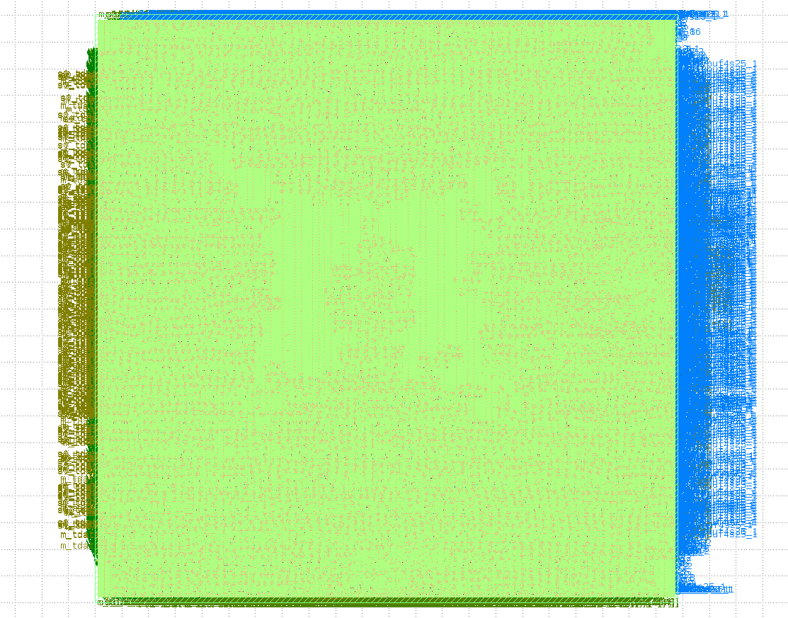
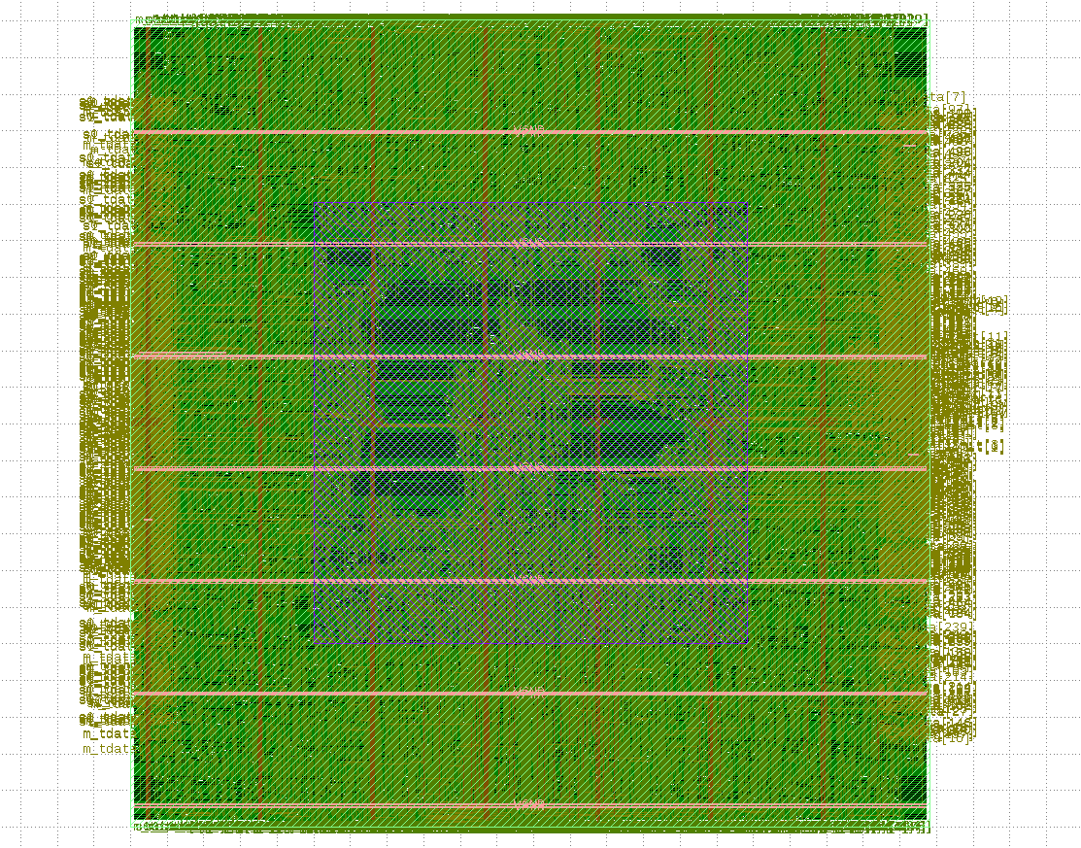
RoboKnights / SARCathon 2026
08
SKY130 — physical implementation status
Reported status on 24 October 2026; interconnect GDSII completed, full-bridge physical sign-off not confirmed.
Layout view 1 · dense cell/routing display
Layout view 2 · metal/routing display
Interconnect (completed)
Full bridge (open)
1.20 mm² die · 41% utilization · ~49k cells · 104 mW
≈3.9 mm² standard-cell area at narrow-profile synthesis.
DRC/LVS/antenna clean; hold met. Slow-corner setup −0.95 ns.
Routing/sign-off not yet demonstrated. X.1 later improved interconnect setup to
−0.52 ns without new GDS stream-out.
AXI4-Stream → PCIe 6.0 Bridge | Round 2 technical review
8 / 10
Notes:
SKY130 physical implementation (≈ 60 s) · Aditya
> We also took the design through LibreLane on SkyWater 130 nanometre.
>
> *[Left]* The interconnect went all the way to GDSII:
> - DRC, LVS and antenna clean, hold met.
> - 1.20 square millimetres at 41% utilisation, about 49,000 cells, 104 milliwatts.
> - Setup at the slow corner was −0.95 nanoseconds, which our X.1 fix improved to −0.52.
>
> *[Right]* For the full bridge we built a narrow ASIC profile from the same RTL: narrow PHY, smaller buffers, 30-nanosecond clock.
> - It went through synthesis, floorplan, placement, clock tree and global routing, about 3.9 square millimetres of cells.
> - Detailed routing didn't converge before the cutoff, so we're not claiming full-bridge sign-off.
>
> *(The reason is on the next slide.)*

Slide 9
RoboKnights / SARCathon 2026
09
Why full-bridge GDSII was not completed by submission
The limiting factors were physical-implementation complexity, available compute and the submission window.
1. RTL and performance target
2. ASIC flow and compute
3. Timing of the final runs
Wide 512-bit processing, parallel CRC/FEC,
The SKY130 flow exposed Yosys
Our initial computing resources were
replay buffering and pipelining supported
latch/logic-loop issues in the RX correction
insufficient to complete the full physical-
high simulation throughput with error-free
path and long full-design runs. We made
design runs within the available time.
delivery in the tested cases. Such a datapath
X.1–X.4 ASIC-compatibility fixes and
Higher-capacity campus compute was
also makes ASIC synthesis, placement and
introduced a narrow, parameterized
identified and secured, but debugging and
routing more demanding.
implementation profile.
reruns extended into the submission
deadline.
Evidence at cutoff
Interconnect GDSII generated and DRC/LVS/antenna checks clean; full bridge synthesized (~3.9 mm² of
standard cells), but full-bridge routing and sign-off remained open.
Latest team-reported RTL simulation: 6.71 GB/s with zero observed data mismatches; earlier documented result: 6.17 GB/s. Final FPGA timing: 255 MHz and positive WNS
(+0.072 ns).
AXI4-Stream → PCIe 6.0 Bridge | Round 2 technical review
9 / 10
Notes:
Why full-bridge GDSII wasn't completed (≈ 60 s) · Aditya
> We want to be upfront about what we didn't finish, and why.
>
> 1. The design itself. The same wide 512-bit processing, parallel CRC/FEC and replay buffering that gave us the throughput also make placement and routing much harder.
> 2. The ASIC flow. It exposed Yosys latch and logic-loop issues in the RX correction path that the FPGA tools never complained about. Our patches X.1 to X.4 fixed those, and we created the narrow implementation profile.
> 3. Compute and time. Our first machines didn't have enough memory for full-design routing. We secured campus compute, but debugging and reruns ran into the deadline. The router ran out of memory once, and on the restart the violations grew instead of falling, which tells us the floorplan is too congested. The next step is a looser floorplan, around 20% core utilisation, with capped router threads.
>
> *[Evidence bar]* At the cutoff:
> - Interconnect GDSII generated and clean.
> - Full bridge synthesized at about 3.9 mm², with routing and sign-off still open.
> - FPGA at 255 MHz with positive slack.
> - The latest team-reported RTL simulation shows 6.71 GB/s with zero data mismatches.
>

Slide 10
RoboKnights / SARCathon 2026
10
Engineering decisions beyond a basic RTL bridge
What we actually implemented and tested—not claims of industry-first functionality.
1.
Two workloads on one fabric
2.
Actual application-level profiling
Programmable weighted arbitration shares the link between
An in-house analyzer tested IMIX traffic, ML tensors, mixed weights,
SmartNIC traffic and ML tensor streaming, with independent channel
4 KB crossings, packet rate and latency—not just Fmax.
sessions.
3.
Design for recoverability
4.
Regression protection
ACK/NAK replay, CRC/FEC correction, link-drop/retrain cases,
46 guard checks and a 40-seed randomized suite helped prevent
resets, overflow and error injection were exercised.
repaired cross-layer bugs from reappearing during optimization.
5.
Measured optimization trade-offs
6.
Two technology profiles
We documented the 118 → 49 MHz timing regression, traced its
Wide FPGA configuration and resource-reduced SKY130
CRC-64 critical path and recovered to 255 MHz.
configuration share RTL, with Yosys-safe logic for ASIC experiments.
Remaining engineering work
Full-bridge SKY130 sign-off, complete I/O timing constraints and improved heavy-noise throughput.
AXI4-Stream → PCIe 6.0 Bridge | Round 2 technical review
10 / 10
Notes:
Engineering decisions (≈ 70 s) · Kshitij
> To close: six things go beyond a basic RTL bridge. These are what we actually built and tested, not claims of anything industry-first.
>
> 1. Two workloads on one fabric. A programmable weighted arbiter shares the link between SmartNIC packets and ML tensors, each with its own session, base address and limit.
> 2. Application-level profiling. Our analyser measures packet rate, tail latency, tensor throughput, 4 KB crossings and mixed weights, not just Fmax.
> 3. Design for recoverability. ACK/NAK replay, FEC correction, overflow handling, hot reset and link-down retrain are all exercised by tests. On the PHY, the link now sends logical idle when it has no data, so a silent lane really means a dead link. The training state machine leaves L0 on signal loss, lost framing or the partner retraining, resets the datapath cleanly and retrains, in about 1,700 clocks.
> 4. Regression protection. At one point two fixes were applied to stale copies of files and nine earlier fixes were silently lost. After that we added 46 guard rules that fail CI if an earlier fix disappears, plus the 40-seed randomized suite.
> 5. Measured trade-offs. We documented the 118-to-49 MHz regression, traced it to CRC-64 and recovered to 255.
> 6. Two technology profiles from one RTL. A wide FPGA configuration and a resource-reduced SKY130 configuration, with Yosys-safe logic for the ASIC.
>
> *[Bottom bar]* What's left: full-bridge SKY130 sign-off, complete I/O timing constraints, and better throughput under heavy channel noise.
>
> Thank you. We're happy to take questions.

